Slide 1
Sleep Patterns Analysis
Yonas Reda

Slide 2
Sleep Patterns Analysis
Investigating Sleep Differences Between Weekdays and Weekends
* Research Question * Data * Hypotheses Testing * Variable * Weekly average stats * T-test result

Slide 3

Research Question
QUESTION:
Does screen time affect the amount of sleep I get per day ?

Slide 4
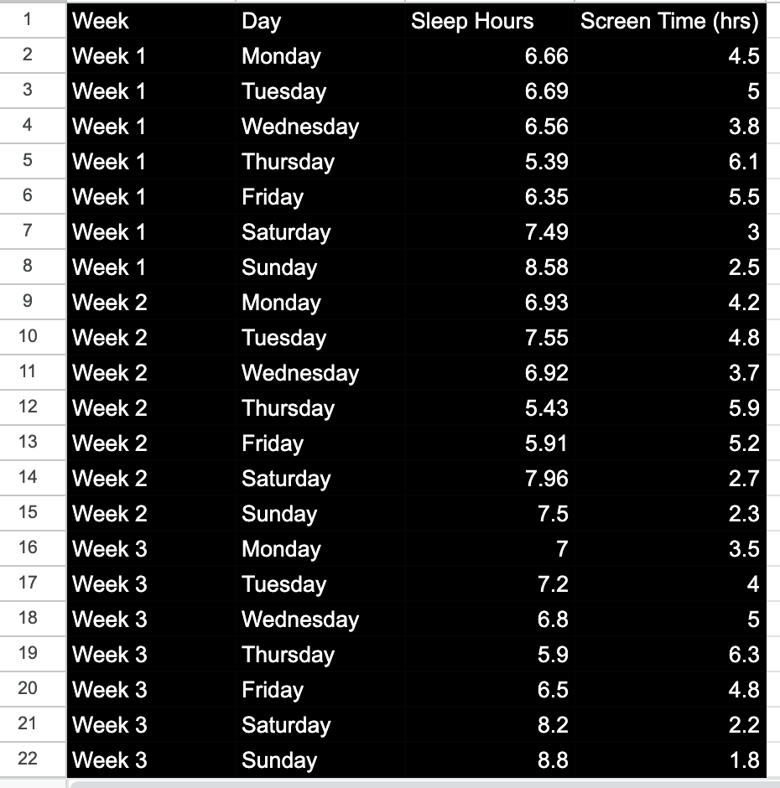


Data
21 days observation Variables
Sleep Hours?
Used Fitness Tracker
Screen Time
App

Slide 5
Hypotheses Testing
Null Hypothesis (H₀​): Screen time does not affect the amount of sleep I get per day.
Alternative Hypothesis (Ha​): Screen time does affect the amount of sleep I get per day.

Slide 6
Variable
Dependent Variable Sleep Hours : This is what we are trying to measure or predict, and it depends on other factors (in this case, screen time and type of day).
Independent Variable Screen Time (hrs): A quantitative variable that might influence sleep hours.

Slide 7
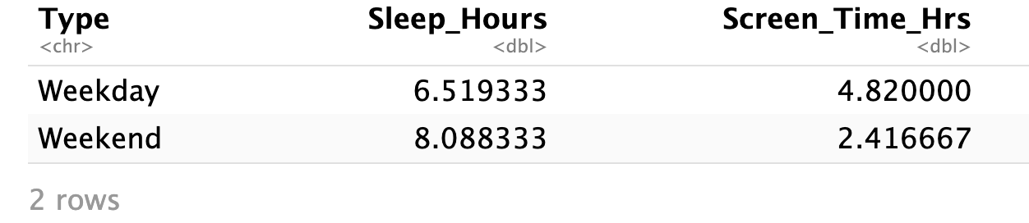
Weekly average stats

Slide 8
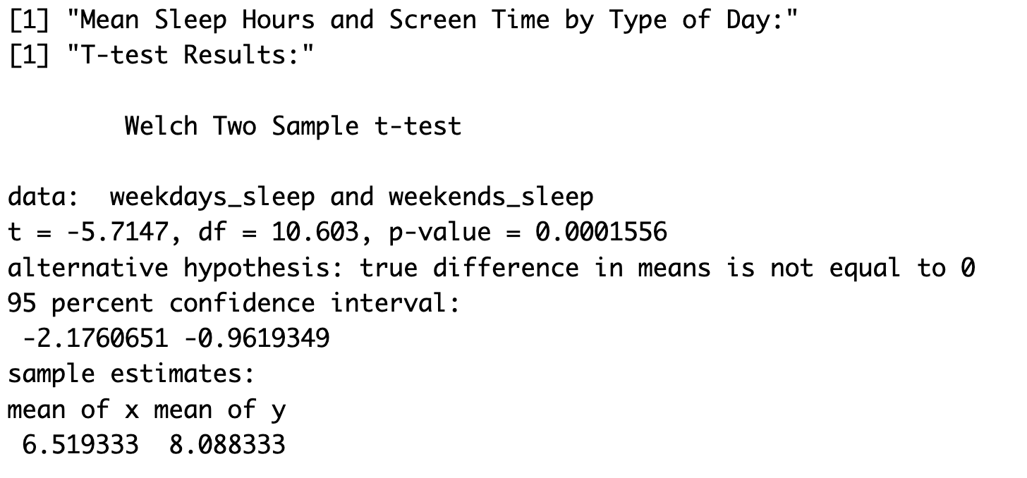
T-test result
Step 3
Test Statistic
T = -5.7147
P-Value = 0.0001556
Step 4
Using a significance level of 0.05, reject the null hypothesis,

Slide 9
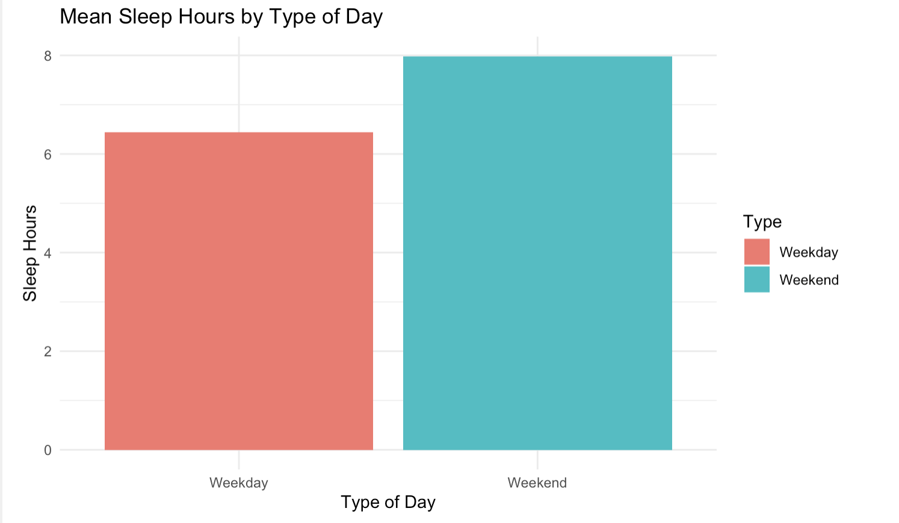
CONCLUSION Stats
The Welch Two Sample T-test output shows the following:
t-value: -5.7147
Degrees of freedom (df): 10.603
p-value: 0.0001556
Confidence interval: (-2.1760651, -0.9619349)
Mean of Weekdays Sleep: 6.519333 hours
Mean of Weekends Sleep: 8.088333 hours

Slide 10
Conclusion:
The p-value (0.0001556) is less than the standard significance level (0.05). So we reject the null hypothesis (Ho​). This indicates that there is a statistically significant difference in the average amount of sleep between weekdays and weekends.
So There is strong evidence to support the alternative hypothesis (Ha​): There is evidence that screen time (or related factors like the type of day) significantly affects the amount of sleep I get.

